Slide 1
Geographic database
PRESENTER:
BIBEK SHARMA
MCA 4TH SEMESTER
ROLL NO 28

Slide 2
CONTENTS
GEOGRAPHICAL DATABASE
Geographical Database Elements
GEOGRAPHIC INFORMATION SYSTEM(GIS)
COMPONENTS OF GIS SYSTEMS
CHARACTERISTICS OF DATA IN GIS
Data types and models
How does it work?
Linkage of Tabular Attributes to Map Feature
GIS Operations And Methods
CREATING TABLES AND SELECTING DATA FROM TABLES
GIS Applications and Software
REFERENCES

Slide 3
GEOGRAPHICAL DATABASE
Database containing geographic data of a particular subject for a particular area
Provide structures for storage and analysis of spatial data
Spatial data is composed of objects in multi-dimensional space
Storing spatial data in a standard database would require excessive amounts of space
A spatial database is an ORDBMS that has the ability to store, query, manipulate and analyze spatial data as well as traditional data formats
It offers spatial data types/data models/ query language
Structure in space: e.g., POINT, LINE, REGION
Relationships among them: (ex:intersects)
It defines data types for points, lines, polygons, multipoint, multiline, and multipolygon

Slide 4
Geographical Database Elements
Entity: a phenomenon of interest in reality that is not further subdivided into phenomena of the same kind eg.city
Object: a digital representation of all or part of an entity. ( city represented by a point or a region)
Entity types: similar phenomena to be stored in a database are identified as entity types. ( road, river…)
Attribute: an attribute is a characteristic of an entity selected for representation.
Layers: spatial objects can be grouped into layers, also called overlays, coverage or themes
Metadata
Spatial Reference System table

Slide 5
GEOGRAPHIC INFORMATION SYSTEM(GIS)
GIS is often defined as a systematic integration of hardware and software for capturing, storing, displaying, updating, manipulating spatial data
It can be viewed as an interdisciplinary area that incorporates many fields of study such as Geodesy, Remote Sensing, Photogrammetry, Environmental Science, etc
SDBMS is a technology used by GIS application (geographic/georeferenced data).
Why is geographic information special?
It describes objects that have a distinct position – attributes and relationship to each other within a defined space

Slide 6
COMPONENTS OF GIS SYSTEMS
GIS systems can be viewed as an integration of three components:-
Hardware and Software
Hardware refers to devices used by end users
Data storage and manipulation is done by using a range of processors
Most GIS follows the 3-tier architechture
Software part relates to the processes used to define, store and manipulate the data
Different models are used to provide efficient means of storage, retrieval and manipulation of the data
Data
Geographic data can be divided into two main groups: vector and raster

Slide 7
COMPONENTS OF GIS SYSTEMS CONTD…
Vector layers in GIS refer to discrete objects represented by points, lines and polygons.
Layers represent geometries that share a common set of attributes
Raster is a continuous grid of cells in two dimensions or the equivalent of voxels in 3D
People
They include cartographers and surveyors and system users

Slide 8
CHARACTERISTICS OF DATA IN GIS
Location
Temporality
Complex spatial features
Thematic values
Fuzzy objects
Entity vs field based values
Generalization
Roles
Object ID
Data quality

Slide 9
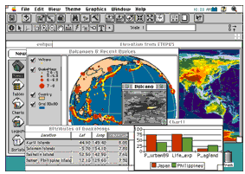
Data types and models
Data for a GIS comes in three basic forms :
Spatial data:
maps are made of spatial data, made up of points, lines, and areas.
Spatial data forms the locations and shapes of map features such as buildings, streets, or cities.
Spatial data are derived from existing maps or aerial photographs.
Image data—using images to build maps
Image data includes such diverse elements as satellite images, aerial photographs, and scanned data=> data that has been converted from paper to digital format

Slide 10
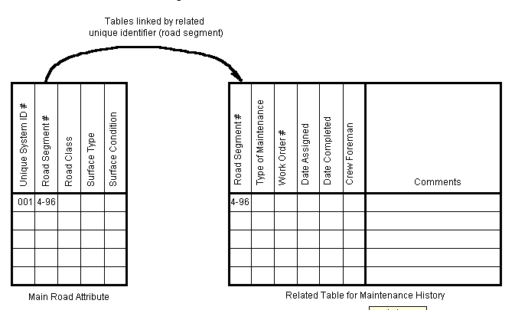
Data types and models contd…
Tabular data:
Tabular data is information describing a map feature. For example, a map of customer locations may be linked to demographic information about those customers.
Use of a database management system (DBMS) to allow the user to define the specific data element types and formats and to store attribute.

Slide 11
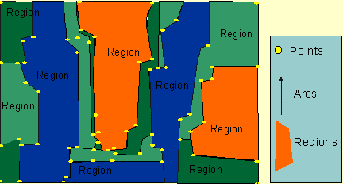
Data types and models contd…
Data can be classified into two types of data models:
Vector model:
displays graphical data as points, lines or curves, or areas with attributes.
Cartesian coordinates and computational algorithms of the coordinates define points in a vector system.
Lines or arcs are a series of ordered points. Areas or polygons are also stored as ordered lists of points
=> Vector data requires less computer storage space and maintaining topological relationships is easier in this system.

Slide 12
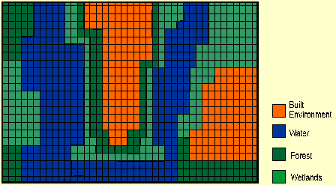
Data types and models contd…
The raster view of the world:
A raster based system displays, locates, and stores graphical data by using a matrix or grid of cells.
these data are two-dimensional, GIS store various information such as forest cover, soil type, land use, wetland habitat, or other data in different layers
=> Raster data requires less processing than vector data, but it consumes more computer storage space.

Slide 13
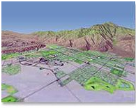
Data types and models contd…
Raster data model (cont) :
Continuous numeric values, such as elevation, and continuous categories, such as vegetation types, are represented using the raster model.
This map shows vector data laid on top of raster data.

Slide 14
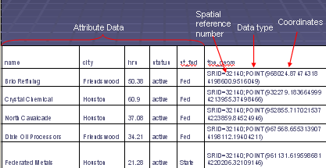
How does it work?
Spatial data is stored using the coordinate system of a particular projection
That projection is referenced with a Spatial Reference Identification Number (SRID)
This number corresponds to another table in the database with all of the spatial reference systems used.
This allows the database to know what projection each table is in, and if need be, re-project those tables for calculations

Slide 15
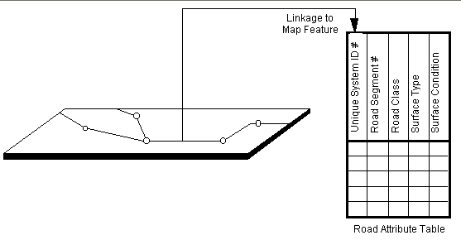
Linkage of Tabular Attributes to Map Feature
How does GIS link between spatial and non spatial data?
How does it link a Location Symbol with Its Meaning ?
Every geographic feature has at least one unique means of identification: a name or number usually just called its ID.
In other words, locational information is linked to specific information in a database

Slide 16
GIS Operations And Methods
Operations
Equal
Disjoint
Intersect
Touch
Cross
Within
Contain
Overlap
Relate
Methods
Distance
Buffer
ConvexHull
Intersection
Union
Difference
SymDifference

Slide 17
CREATING TABLES AND SELECTING DATA FROM TABLES
The following example illustrates the creation of tables
CREATE TABLE STATES
(
Sname VARCHAR(50) NOT NULL,
State_shape POLYGON NOT NULL,
Country VARCHAR(50),
PRIMARY KEY(Sname),
FOREIGN KEY(Country) REFERENCES COUNTRIES (Cname)
);
Statement that retrieve states with an area greater than 50000 is as follows:
SELECT Sname
FROM STATES
WHERE (AREA(State_shape)>50000);

Slide 18
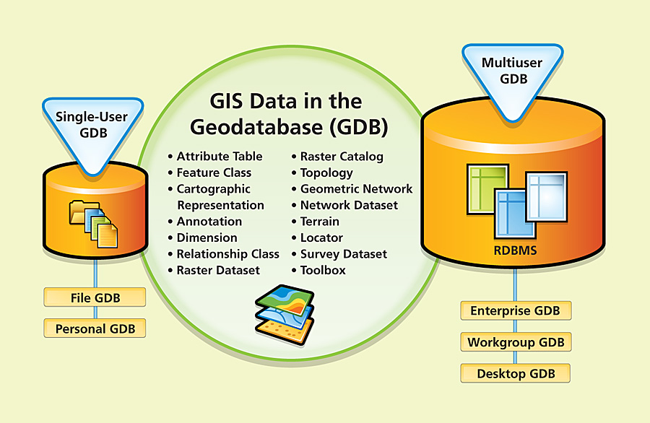
GIS Applications and Software
Applications
Military
Government
Health Sector
Environment Science
Navigation
City Planning
Emergency Services
Census tracking
Software
ArcINFO
Geodatabase

Slide 19
REFERENCES
www.aui.ma/personal/~D.Kettani/courses/gis/GDB-benkirane.ppt
Fundamentals of Database Systems Fifth Edition Ramez Elmasri, Shamkant B. Navathe

Slide 20


